Slide 1
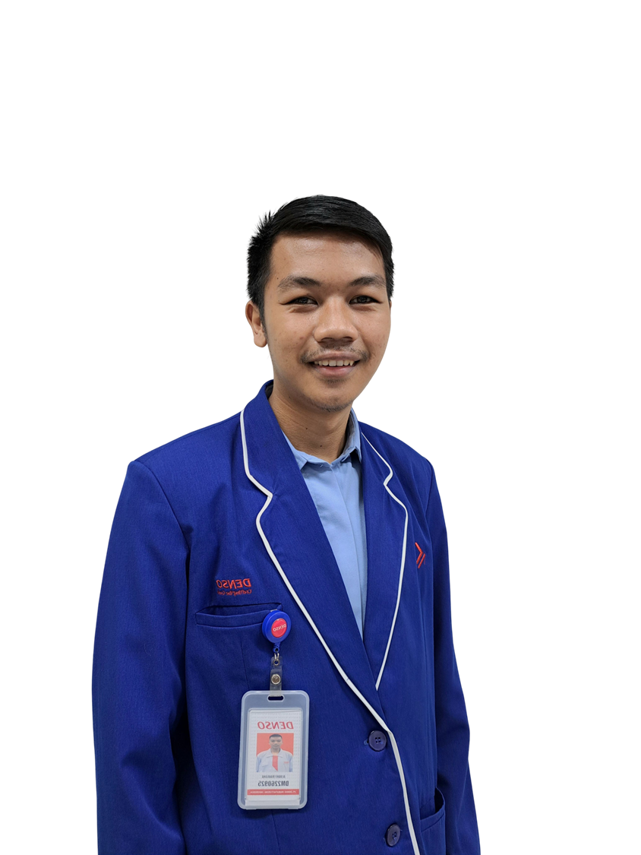
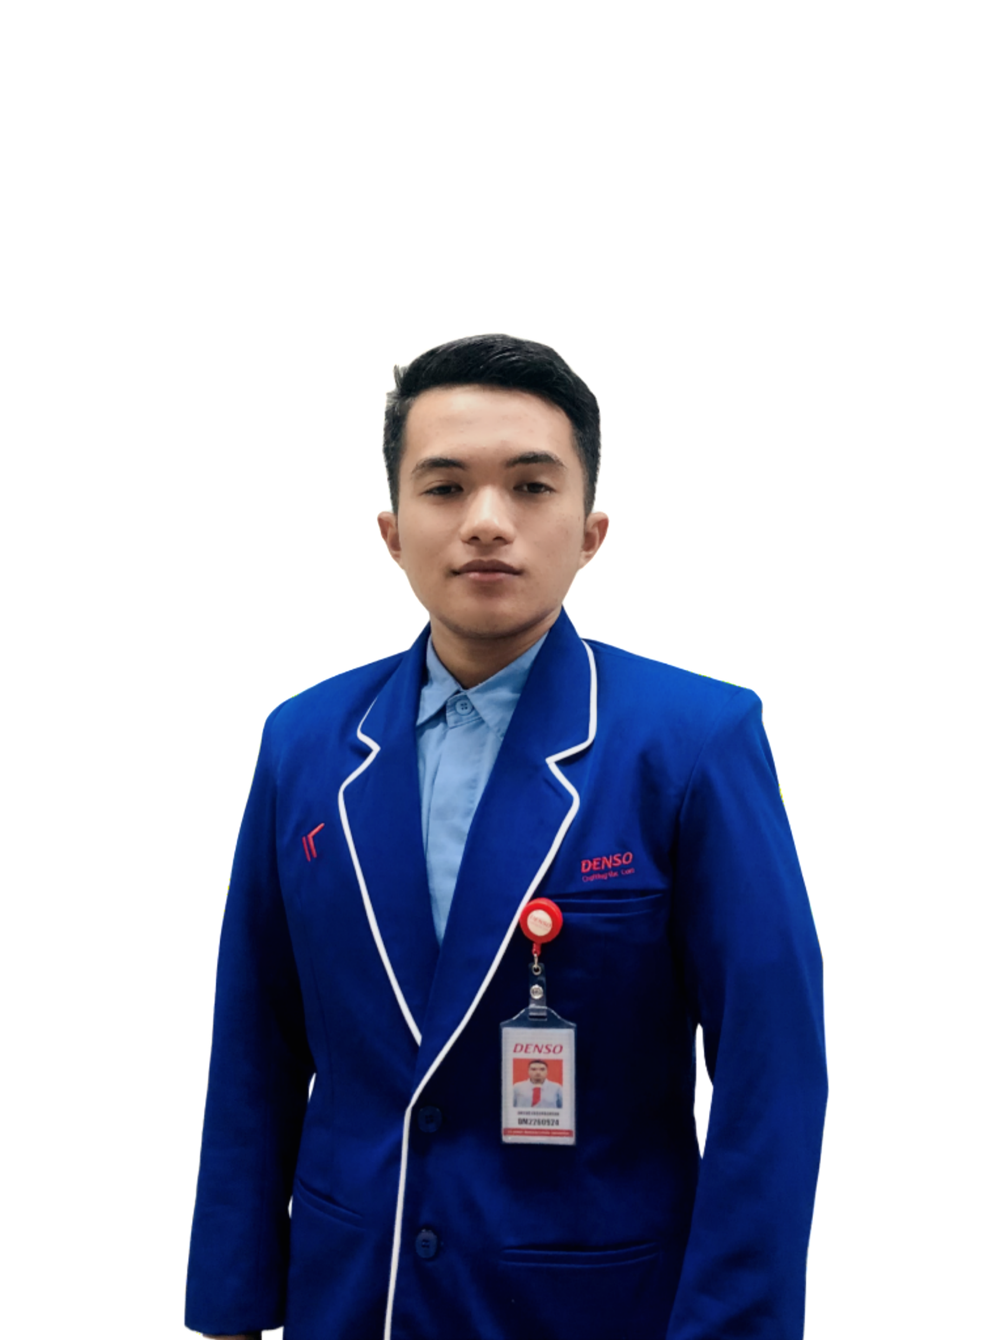
DX
MATRAS
ACTIVITY
TEAM 4
Management Training System
Alvany
Maulana
Ahmad
Abdurrahman
“Optimizing Training System for
Human Performance
by Digitalization system”
Ahmad Abdurrahman : DM2260924
Alvany maulana : DM2260925

Slide 2


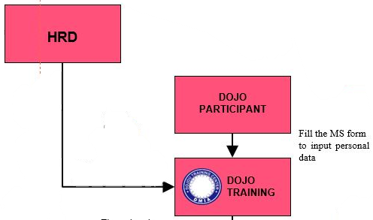







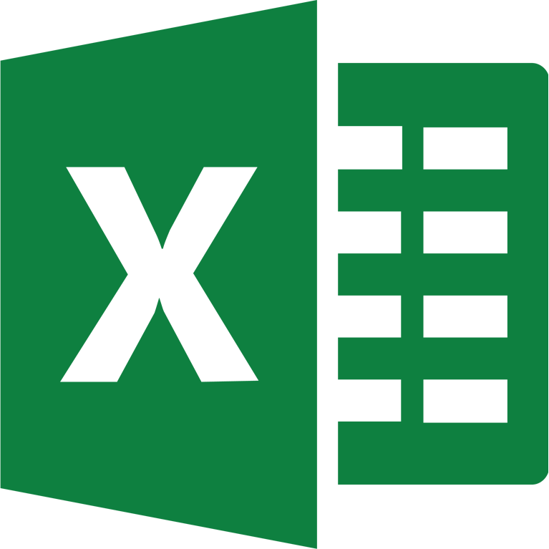



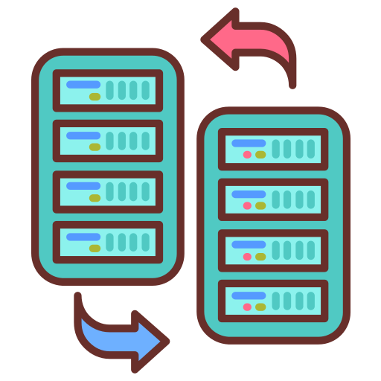










A Smart Transformation in
TIMELINE
Management Training System
10-14 july 2023
31-2 august 2023
WOT
Transfer participant data by WA Group
Prepare
Development
Trial
Presentation
CURRENT PROBLEM
Efficient and Effective
Management Training
16-27 july 2023
4 august 2023
There are participants who double the training.
so it wastes time
GOALS
The data input process is still manual so it is not effective
when one process = 5 minutes
Total Process Need times for
... Minutes
Reduce man hour with effective work and accuracy programming data.
Excel
Ms.Form
There is a repeat of sending participant data through to
HR ➔ Muda process
Get data from ms Form ➔ Copy to Excel ➔ Edit
There are
10 process worked
by input manually
How We Do?
1. Dojo ➔ Result score to HRD
There is no MIRUKA About Summary data
1
3
4
2. HRD ➔ Data MCU to Dojo
Create participant imports that can detect duplicate participants
Create a bank participant so that people who pass automatically enter
Export Table by excel
3. Dojo ➔ Distribution Data to HRD
TARGET
2
5
Make import scores per subject so that it is efficient
Added HR features that can monitor the results of the dojo
1
Efficiency of Inputting Data
3
Secured participant’s history data
System that can detect duplicate participants
Monitoring control by HR directly
2
4

Slide 3
DETAIL SYSTEM
Before improve
Manual data entry:
Participant's Personal Data
Score Each Subject
Score of daily exercise
Proses data
Detect double participant by whatsapp group
Copy and paste personal data until daily score
Manual input data bank participant from summary score
Transfer data to HR
Send to HR data participant passed with email
MCU score Revision Sent Again to Dojo
After improve
Import data entry:
Personal data, sport score, and score each subject
Proses data
Data is automatically integrated and automatically entered into the participant's bank
Tranfer data to HR
With HR features that can directly export data to excel and can edit MCU results
3. Peralatan
Visual code with( php, java script, ajax, html)
Sql server
Web server
visualization
Chart js
bootstrap
4. Fitur
Import participant from excel
Detect participant retraining
Import score each subject
Bank participant automaticly
Export to excel
Dashboard
Hr fitur

